Slide 1
Sorting in Linear Time
By
Tanvir Ahammad
Lecturer
Dept. of CSE, JnU.

Slide 2
Counting Sort
It assumes that each of the n input elements is an integer in the range 0 to k, for some integer k, i.e.
the input n elements are equal to or less than key integer element
Counts the number of distinct elements and then place the elements in output as in the input order;
It does not require any comparison like others e.g., insertion, selection, or merge sort
It is stable: numbers with the same value appear in the output array in the same order as they do in the input array
it breaks ties between two numbers by the rule that whichever number appears first in the input array appears first in the output array;
It also works as a subroutine for radix sort algorithm

Slide 3
Main idea
Uses three arrays: one input and output arrays of n length, and a temporary array for counting numbers in the range 0……k (key element)
initially set 0s in the temporary array
Count the distinct input elements and put in temporary array
So some arithmetic to calculate the position of each object in the output sequence

Slide 4
Example
Input data:2,5,3,0,2,3,0,3
Key element: 5 (0-5)

Slide 5
Cont.…
 | 1 | 2 | 3 | 4 | 5 | 6 | 7 | 8
A | 2 | 5 | 3 | 0 | 2 | 3 | 0 | 3
 | 0 | 1 | 2 | 3 | 4 | 5
C | 0 | 0 | 0 | 0 | 0 | 0

Slide 6
Cont.…
 | 1 | 2 | 3 | 4 | 5 | 6 | 7 | 8
A | 2 | 5 | 3 | 0 | 2 | 3 | 0 | 3
 | 0 | 1 | 2 | 3 | 4 | 5
C | 0 | 0 | 1 | 0 | 0 | 0
 | 0 | 1 | 2 | 3 | 4 | 5
C | 0 | 0 | 1 | 0 | 0 | 1
 | 0 | 1 | 2 | 3 | 4 | 5
C | 0 | 0 | 1 | 1 | 0 | 0
 | 0 | 1 | 2 | 3 | 4 | 5
C | 2 | 0 | 2 | 3 | 0 | 1

Slide 7
Cont…
Compute cumulative counting in temporary array starting from 1 to kth index:
C[1]+C[1-1]=0+2=2
C[2]+C[2-1]=2+2=4
Similarly,
 | 0 | 1 | 2 | 3 | 4 | 5
C | 2 | 0 | 2 | 3 | 0 | 1
 | 0 | 1 | 2 | 3 | 4 | 5
C | 2 | 2 | 2 | 3 | 0 | 1
 | 0 | 1 | 2 | 3 | 4 | 5
C | 2 | 2 | 4 | 3 | 0 | 1
 | 0 | 1 | 2 | 3 | 4 | 5
C | 2 | 2 | 4 | 7 | 7 | 8

Slide 8
Cont.…
Now we place the number in the correct position of output array and decrease counting in temp array
 | 1 | 2 | 3 | 4 | 5 | 6 | 7 | 8
A | 2 | 5 | 3 | 0 | 2 | 3 | 0 | 3
 | 0 | 1 | 2 | 3 | 4 | 5
C | 2 | 2 | 4 | 7 | 7 | 8
 | 1 | 2 | 3 | 4 | 5 | 6 | 7 | 8
B |  |  |  |  |  |  | 3
 | 0 | 1 | 2 | 3 | 4 | 5
C | 2 | 2 | 4 | 6 | 7 | 8

Slide 9
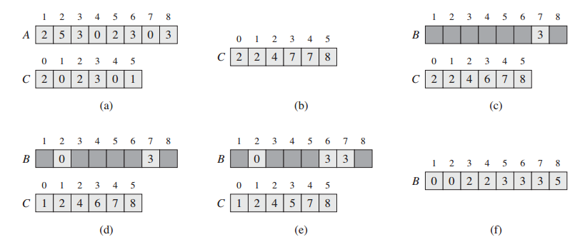
Cont.…
Putting all together

Slide 10
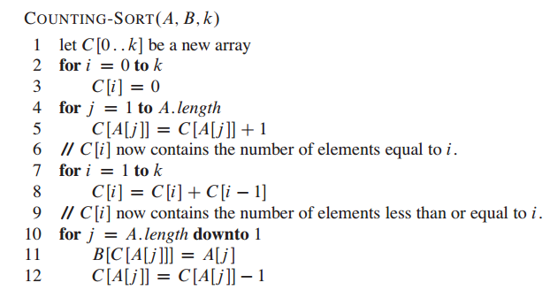
Counting sort algorithm

Slide 11
Exercise
illustrate the operation of COUNTING-SORT on the array A={6; 0; 2; 0; 1; 3; 4; 6; 1; 3; 2}.
Prove that COUNTING-SORT is stable.
Suppose that we were to rewrite the for loop header in line 10 of the COUNTINGSORT as
10 for j =1 to A:length
Show that the algorithm still works properly. Is the modified algorithm stable?

Slide 12
How much time does counting sort require?
the for loop of lines 1-2 takes time O(k),
the for loop of lines 3-4 takes time O(n),
the for loop of lines 6-7 takes time O(k), and
the for loop of lines 9-11 takes time O(n).
Thus, the overall time is O(k + n).
In practice, we usually use counting sort when we have k = O(n), in which case the running time is O(n).

Slide 13
Radix sort
It is a non-comparative integer sorting algorithm that sorts data with integer keys by grouping keys by the individual digits which share the same significant position and value.

Slide 14
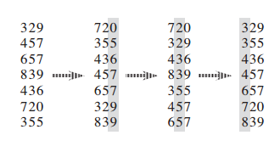
Example

Slide 15
Exercise
Illustrate the operation of RADIX-SORT on the following list of English words: COW, DOG, SEA, RUG, ROW, MOB, BOX, TAB, BAR, EAR, TAR, DIG, BIG, TEA, NOW, FOX.

Slide 16
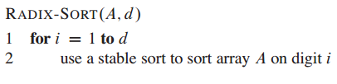
Algorithm
The algorithm is very simple, if you know counting sort, then you can easily implement it.

Slide 17
Bucket sort
Bucket sort assumes that the input is drawn from a uniform distribution and has an average-case running time of O(n).
Like counting sort, bucket sort is fast because it assumes something about the input
Whereas counting sort assumes that the input consists of integers in a small range, bucket sort assumes that the input is generated by a random process that distributes elements uniformly and independently over the interval [0,1)

Slide 18
Main idea
Goal: sort a large set of floating point numbers which are in range from 0.0 to 1.0 and are uniformly distributed across the range.
Steps:
1) Create n empty buckets (Or lists).
2) Do following for every array element arr[i].
a) Insert arr[i] into bucket[n*array[i]]
3) Sort individual buckets using insertion sort.
4) Concatenate all sorted buckets.

Slide 19
Example

Slide 20

Example: Visualization

Slide 21
Exercise
Illustrate the operation of BUCKET-SORT on the array A={.79; .13; .16; .64; .39; .20; .89; .53; .71; .42}

Slide 22
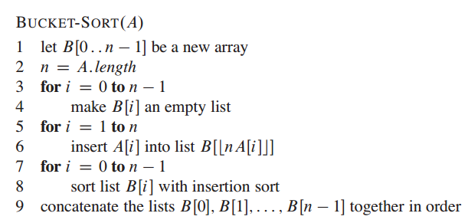
Algorithm

Slide 23
Complexity
If we assume that insertion in a bucket takes O(1) time then steps 1 and 2 of the algorithm clearly take O(n) time
The O(1) is easily possible if we use a linked list to represent a bucket (In the following code, C++ vector is used for simplicity).
Step 4 also takes O(n) time as there will be n items in all buckets
The main step to analyze is step 3
This step also takes O(n) time on average if all numbers are uniformly distributed (please refer Corman book for more details)

Slide 24
ShellSort

